Slide 1
DevOps

Slide 2
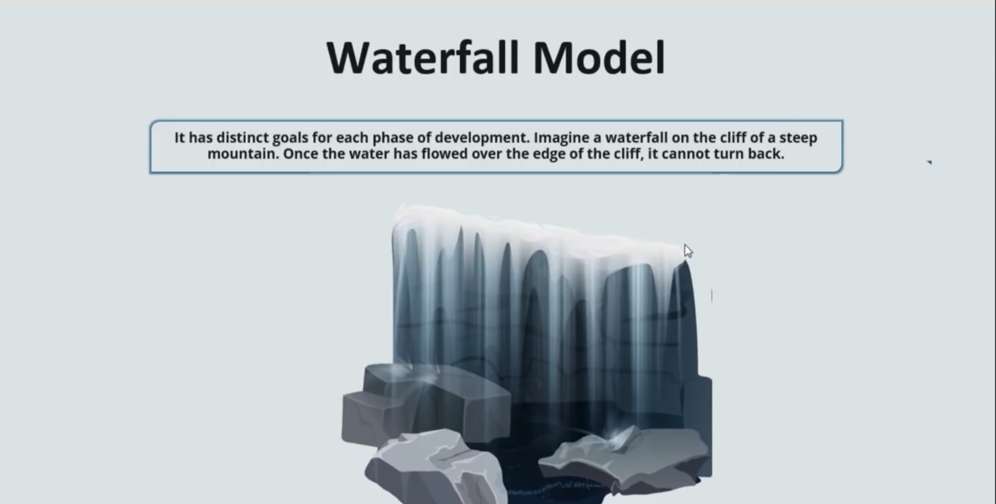

Slide 3
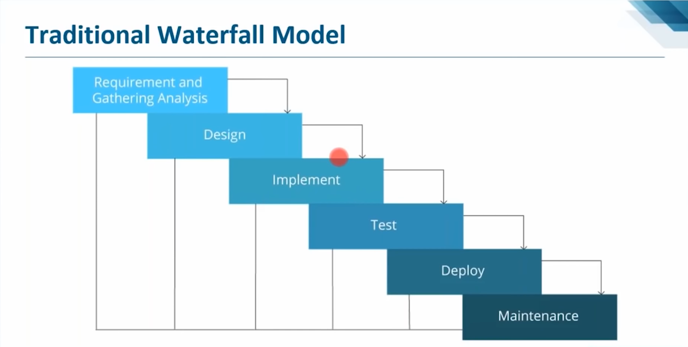

Slide 4
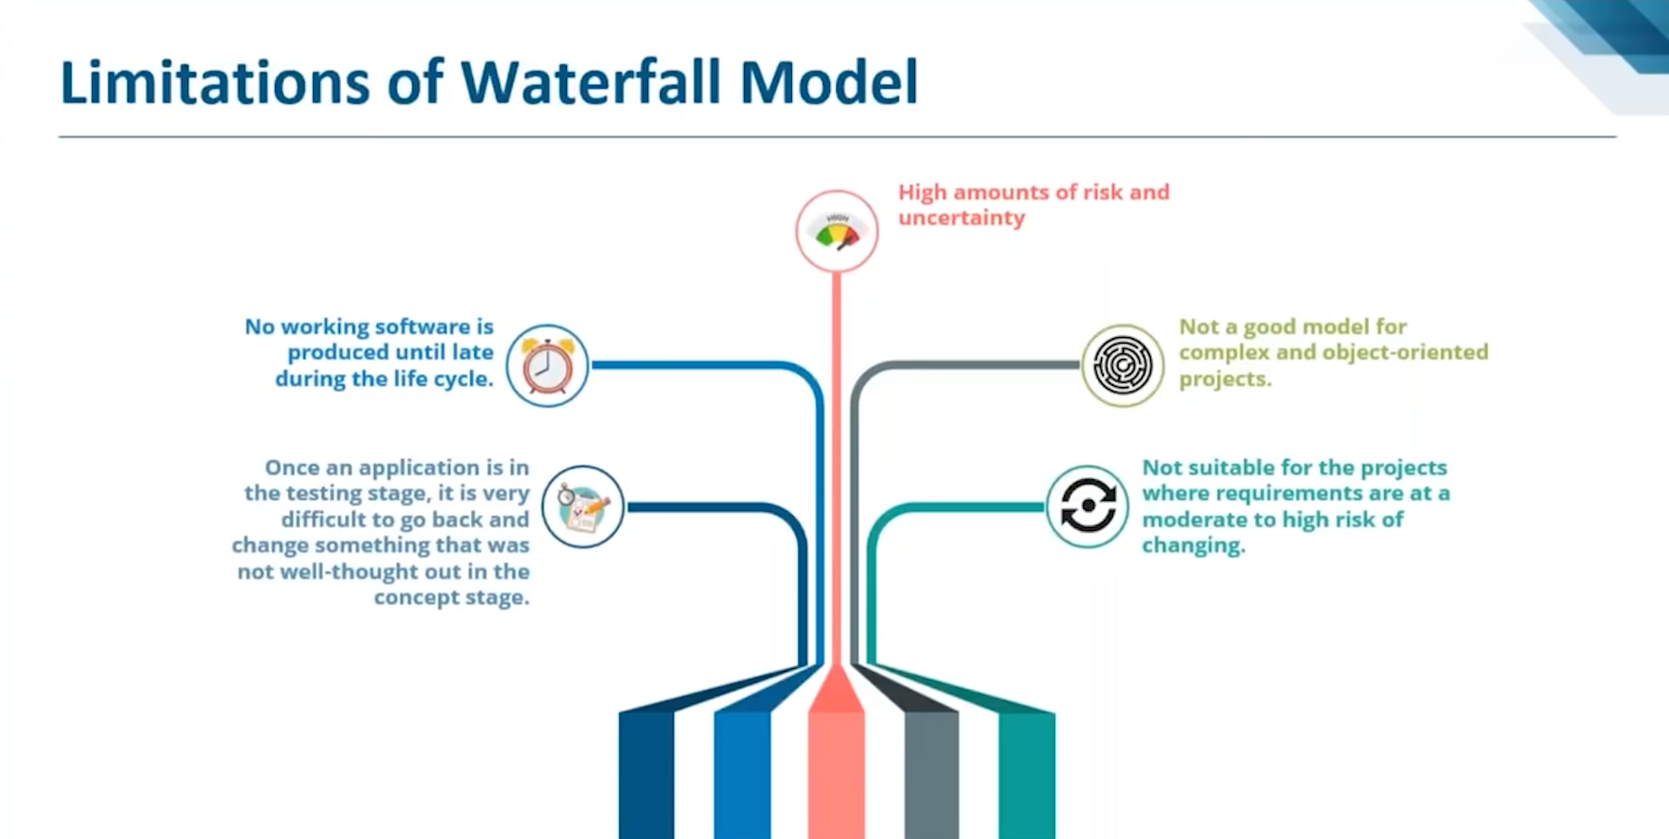

Slide 5
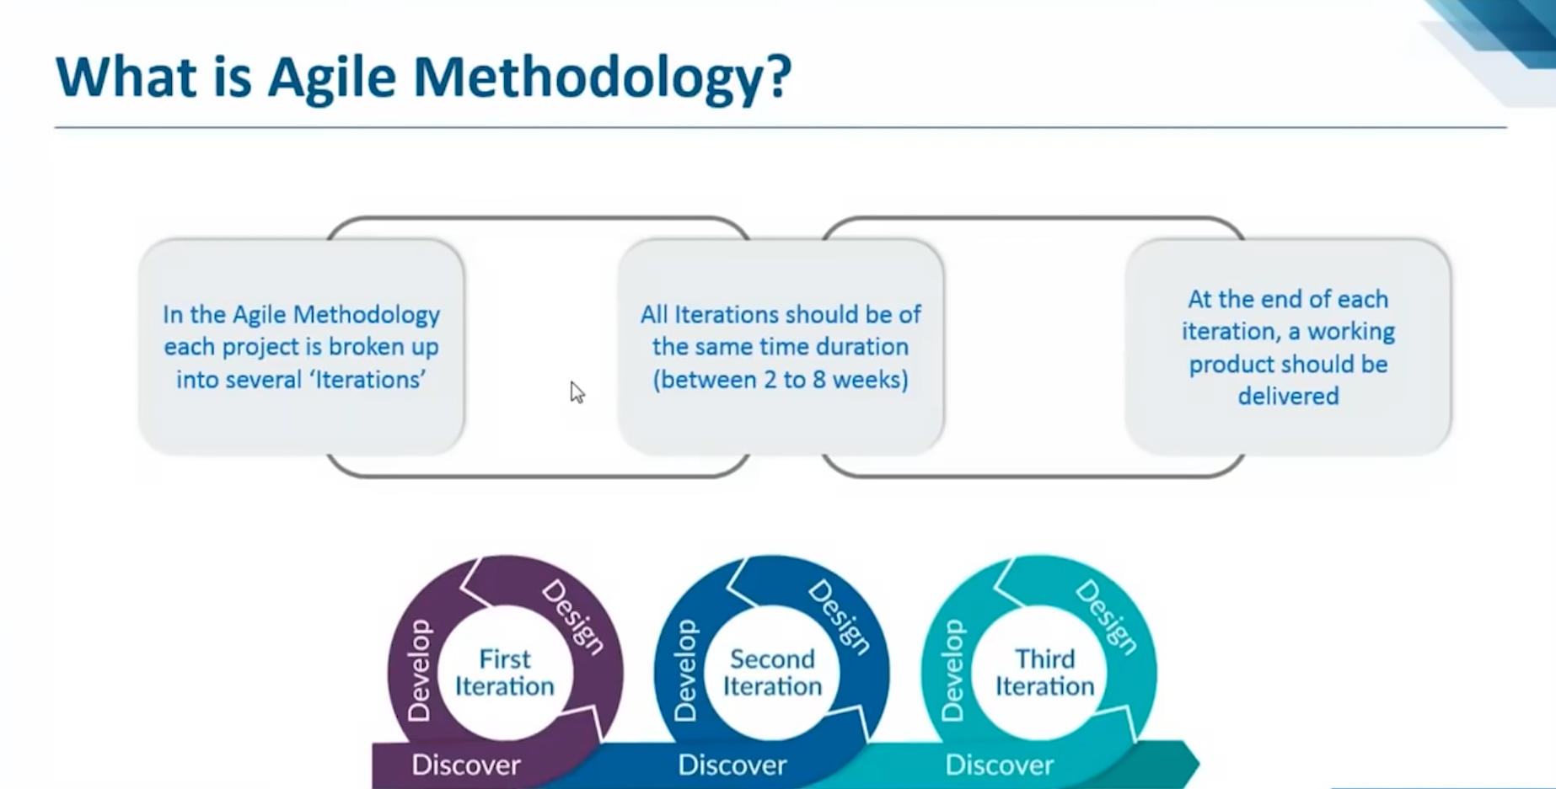

Slide 6
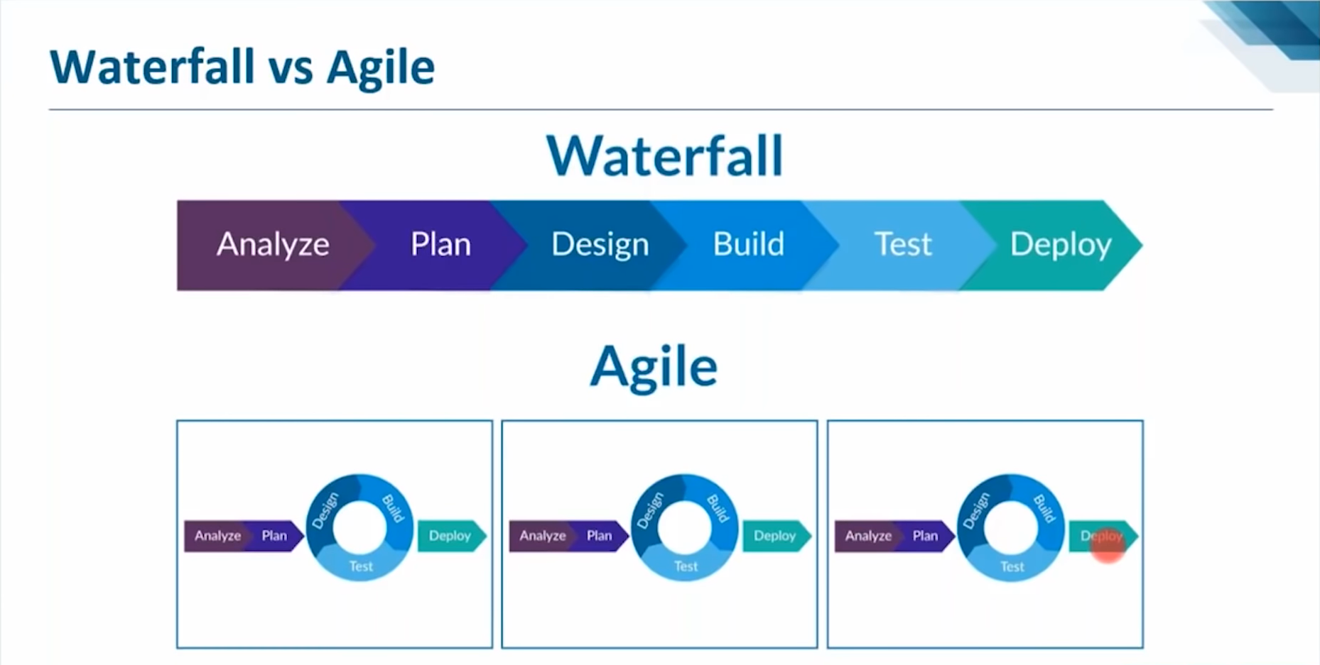

Slide 7
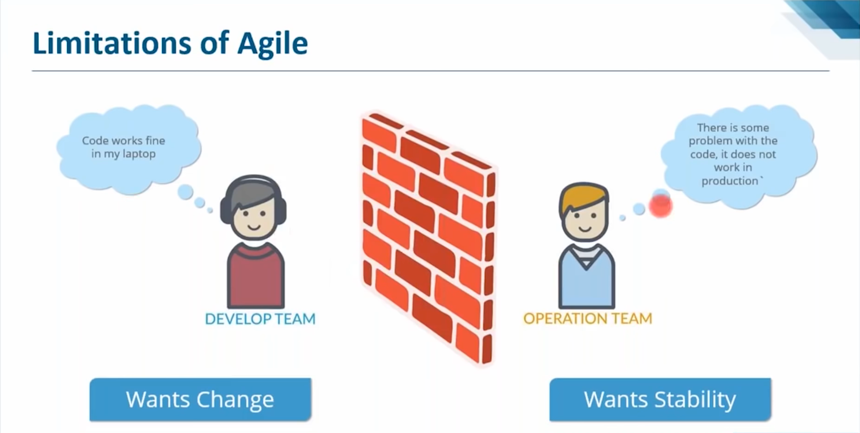

Slide 8
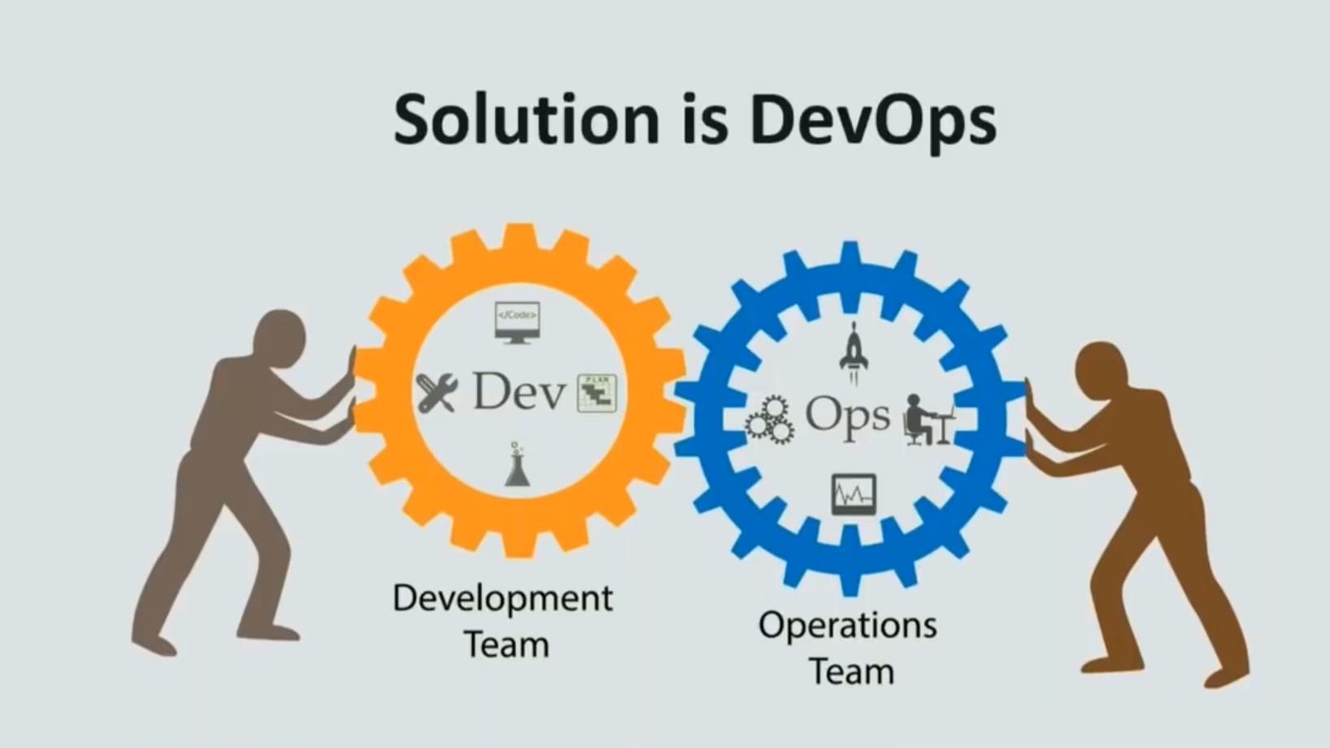

Slide 9
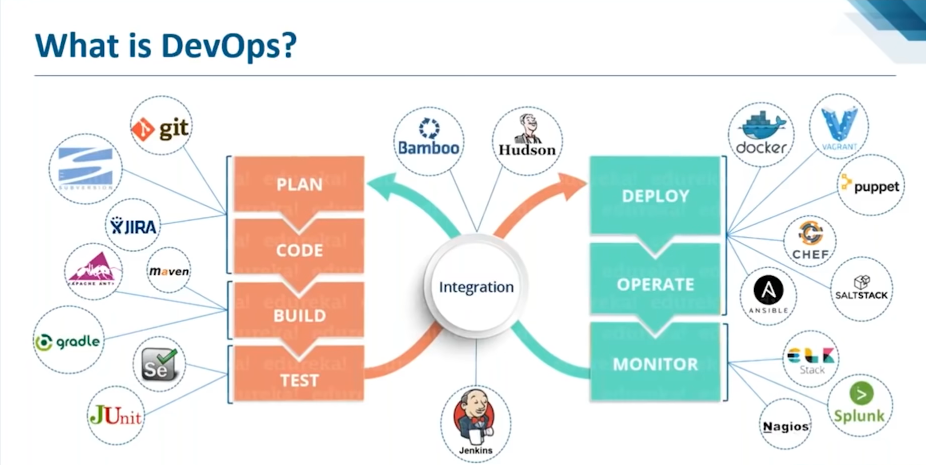

Slide 10
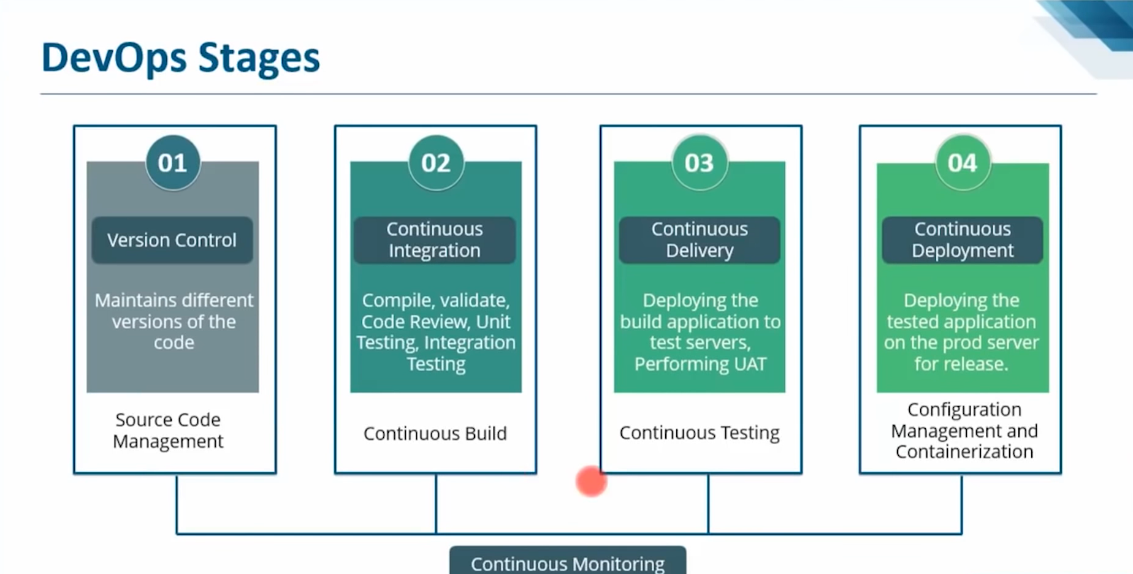

Slide 11
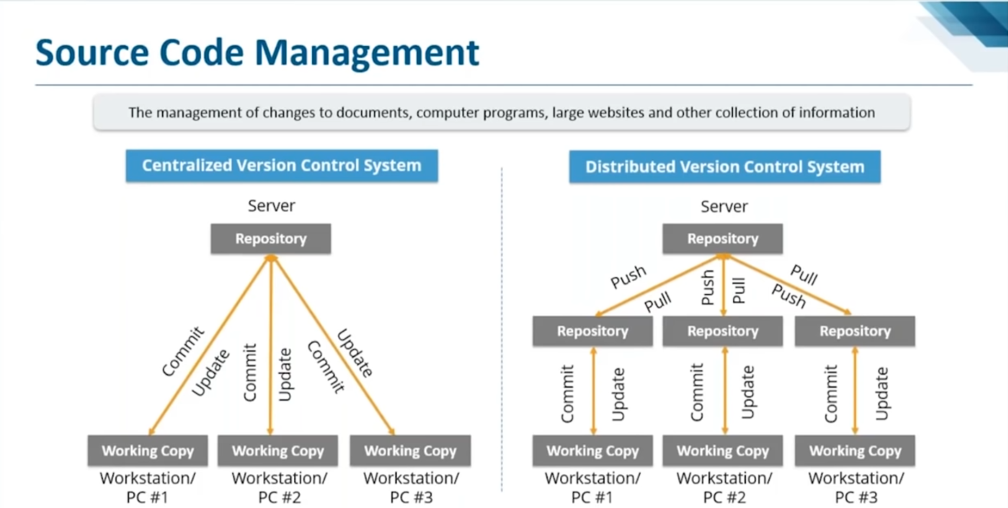

Slide 12
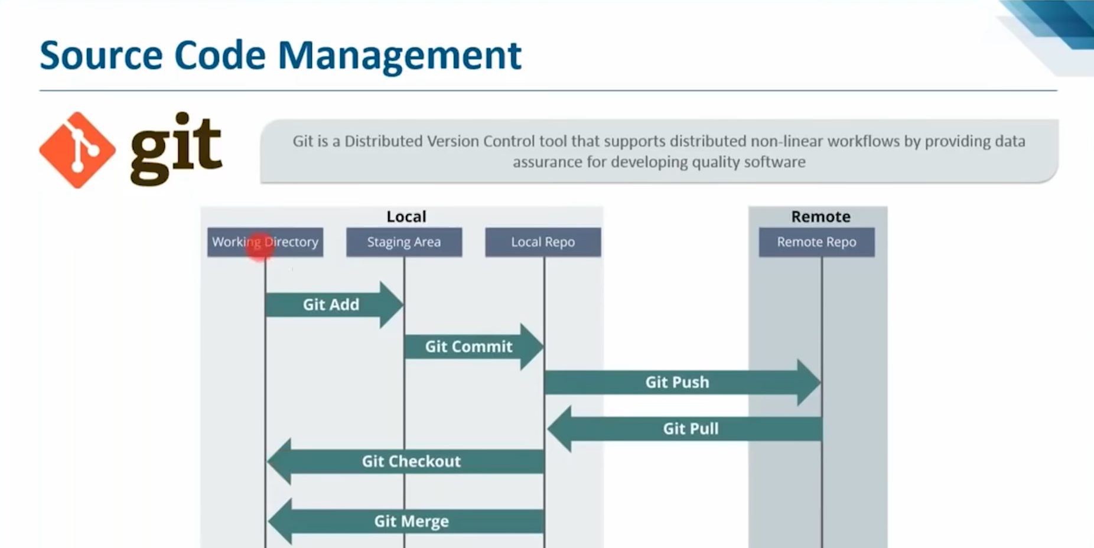

Slide 13
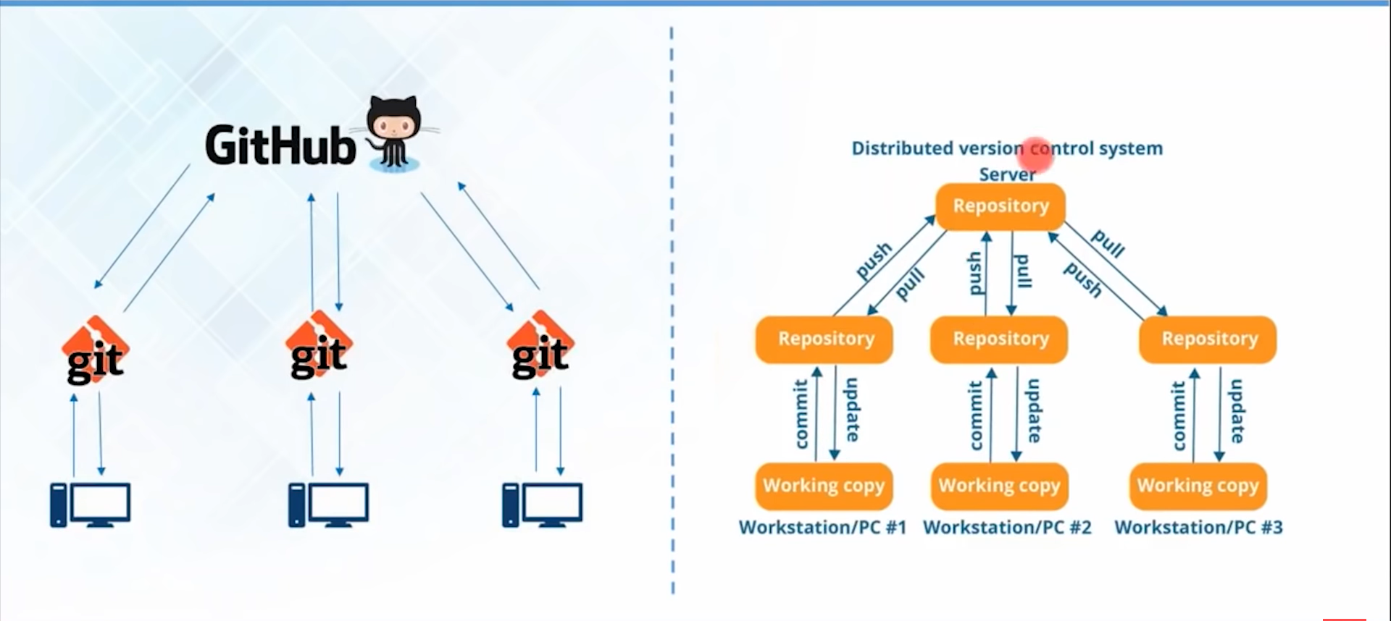

Slide 14
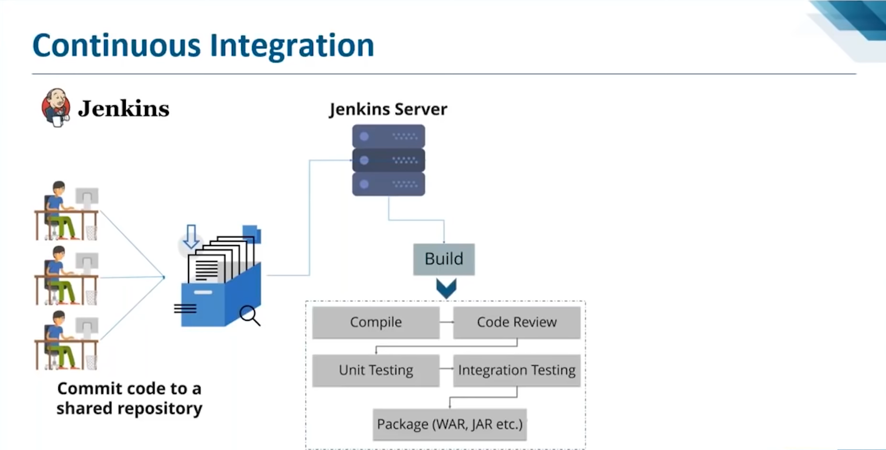

Slide 15
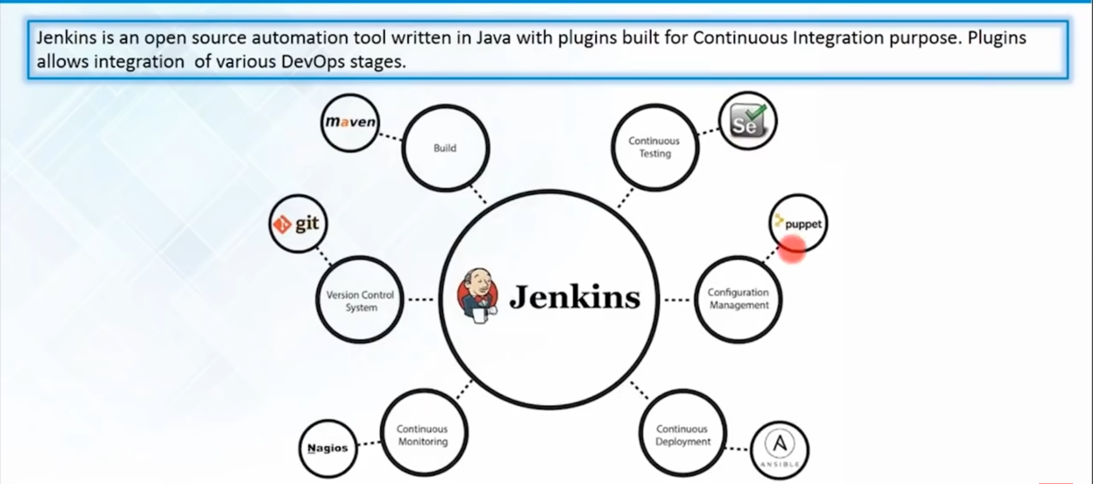

Slide 16
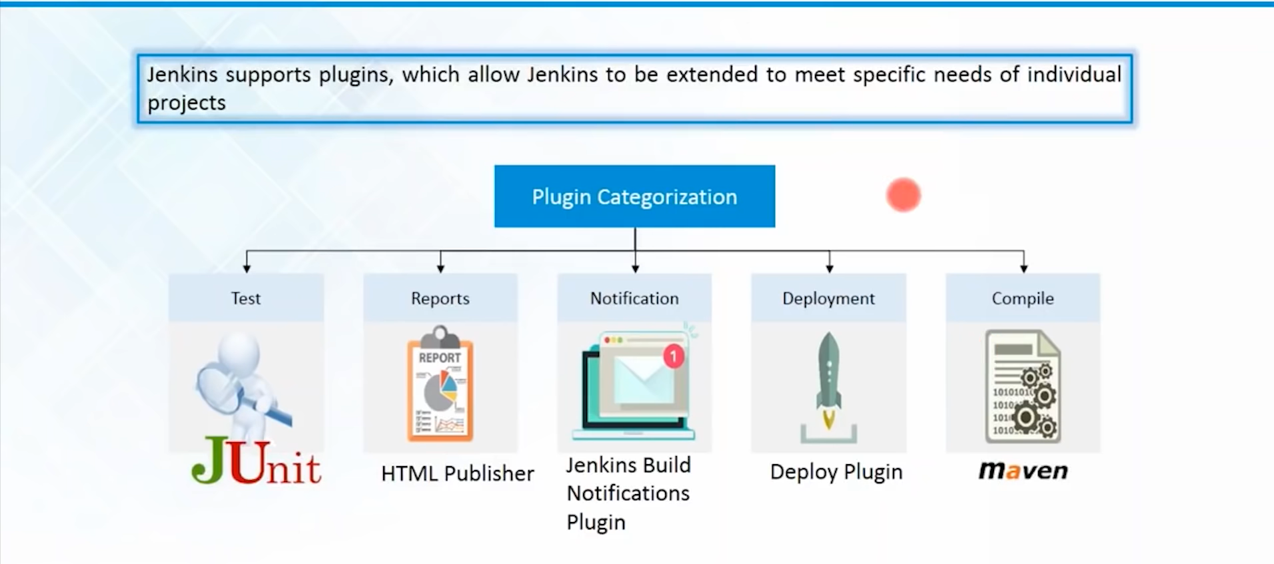

Slide 17
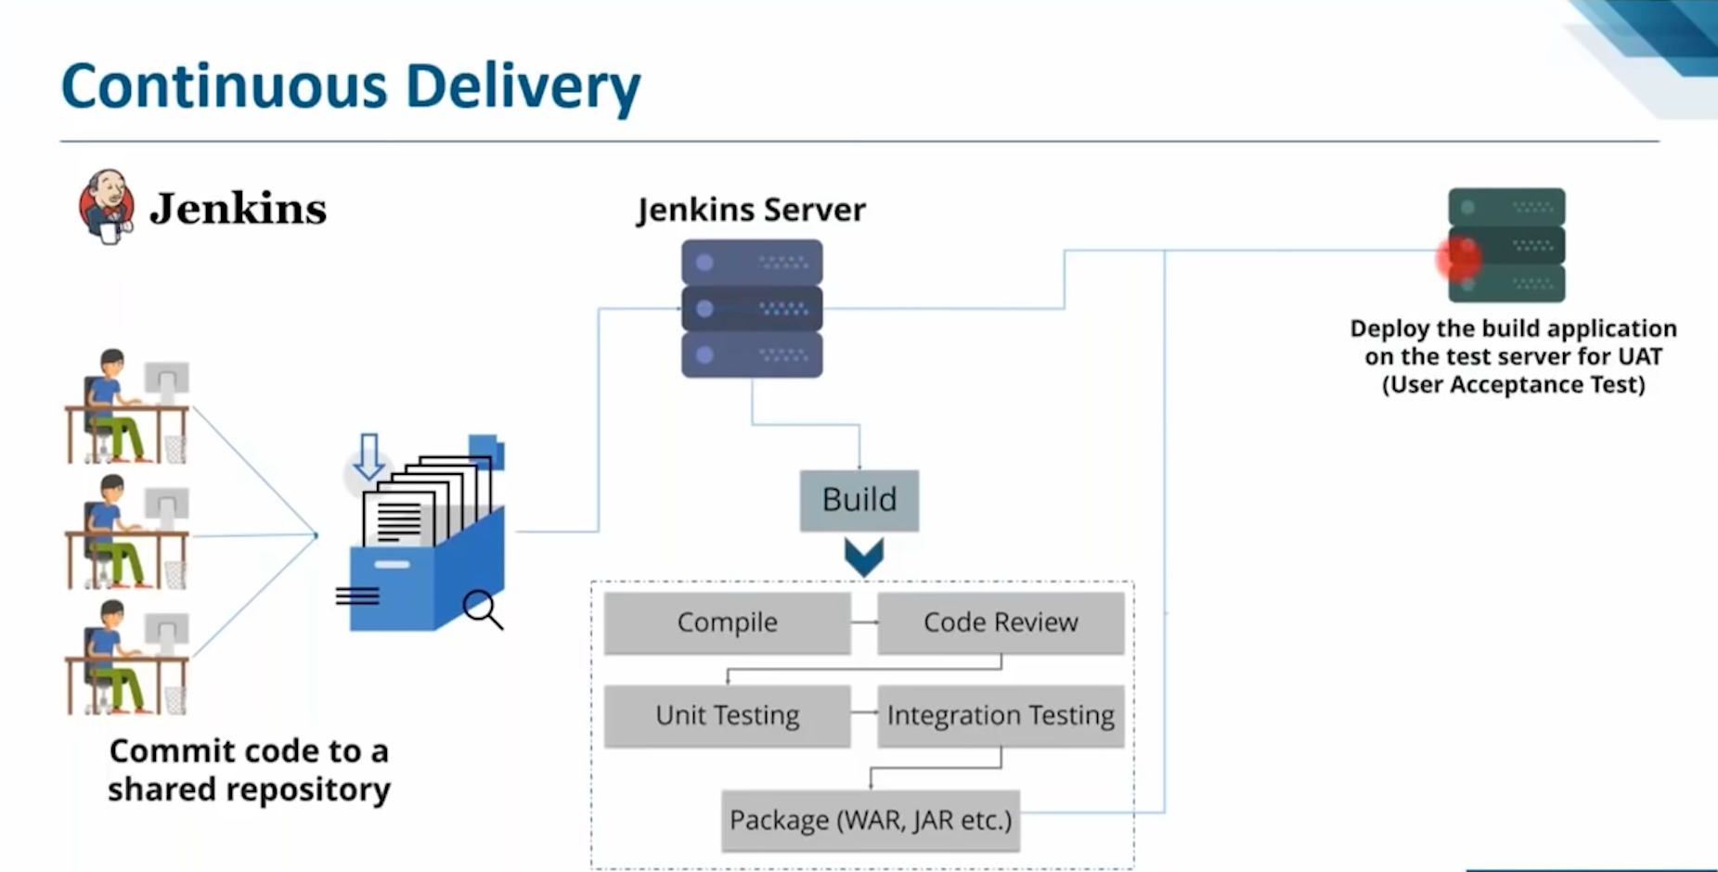

Slide 18
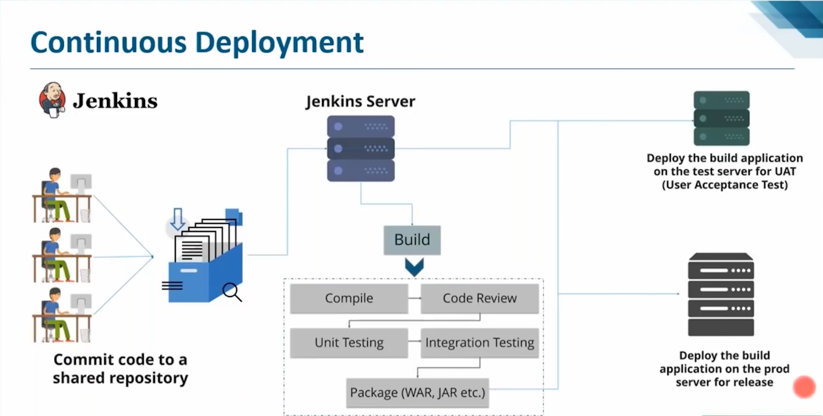

Slide 19
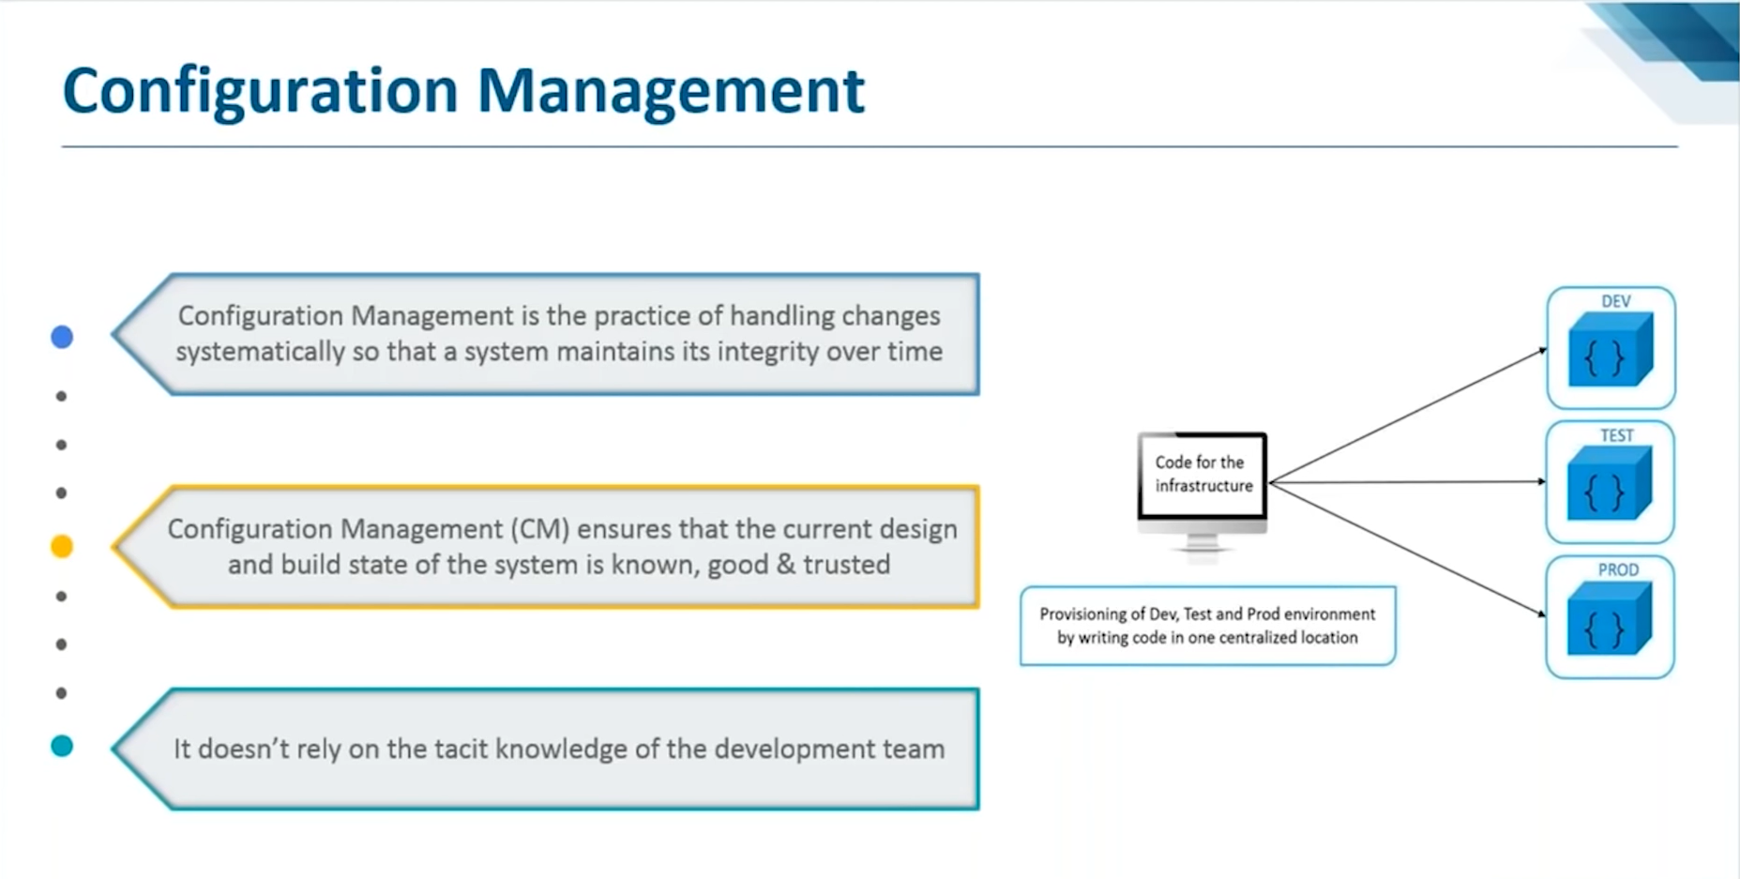

Slide 20
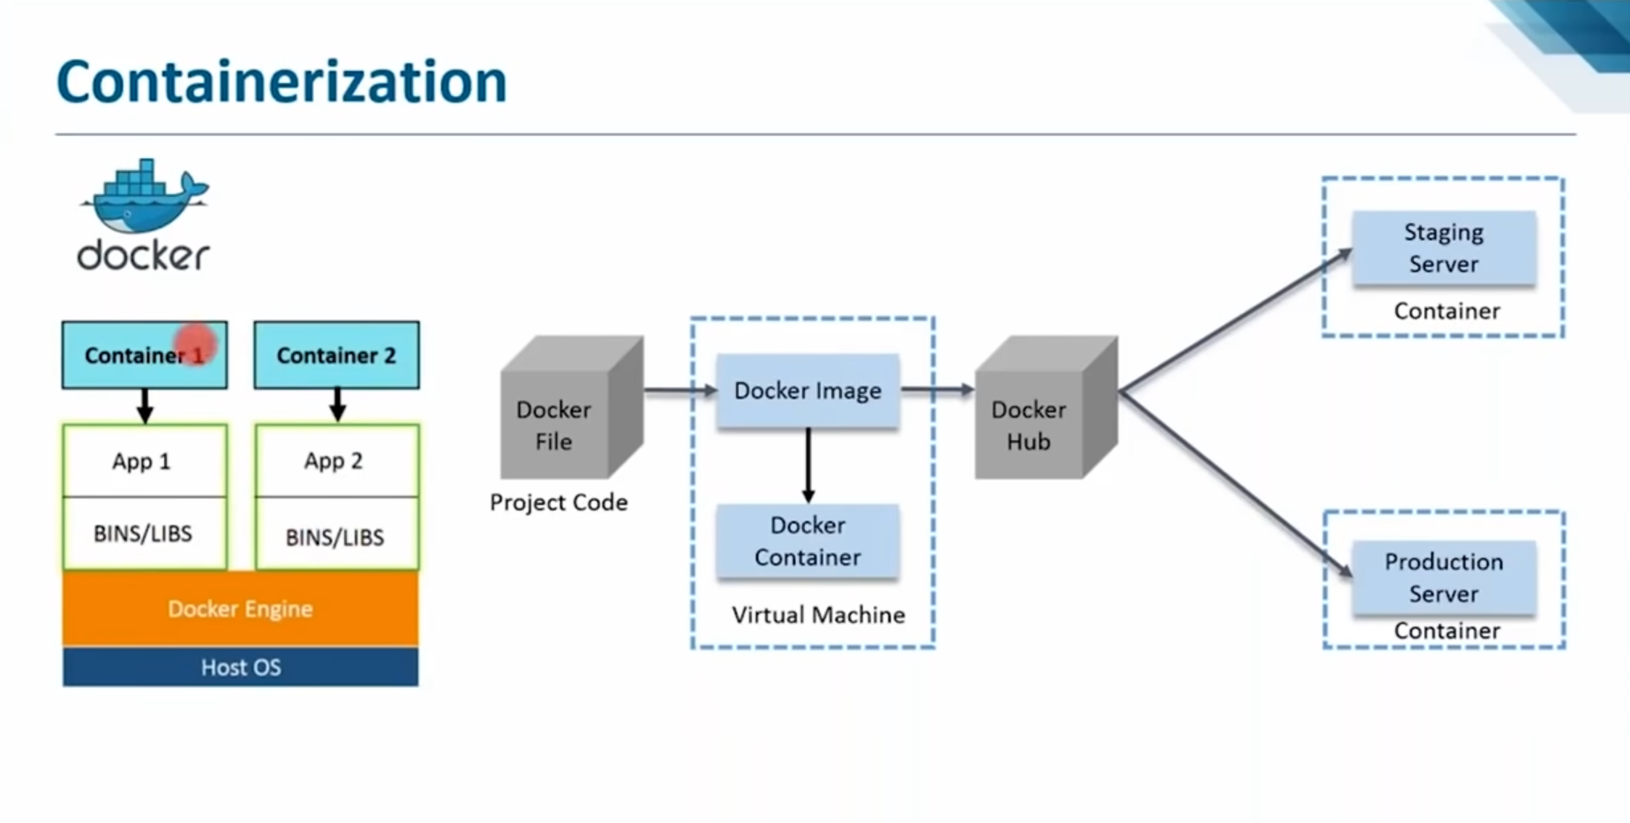

Slide 21
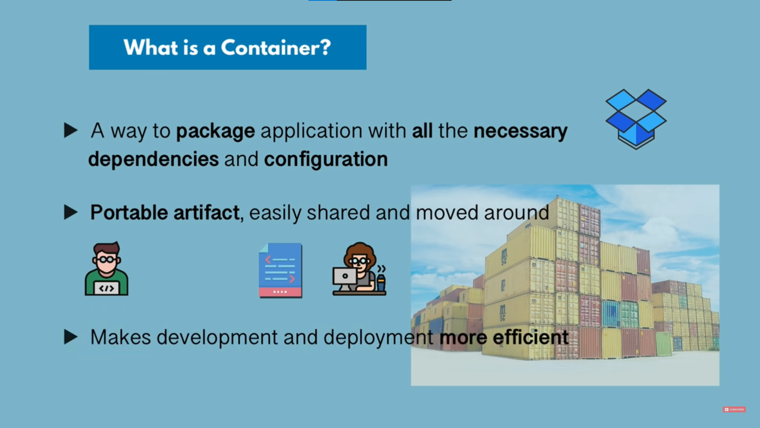

Slide 22
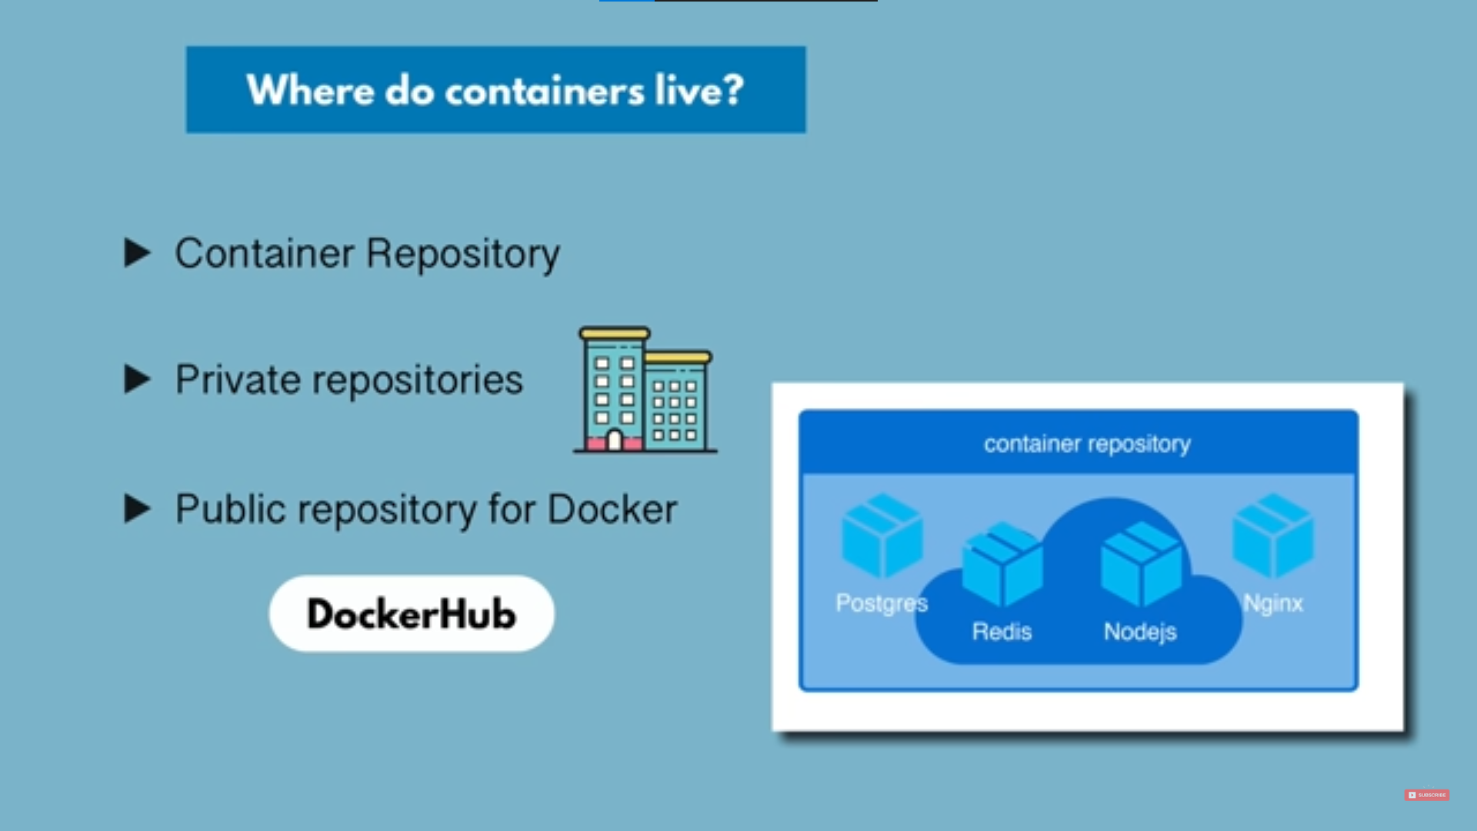

Slide 23
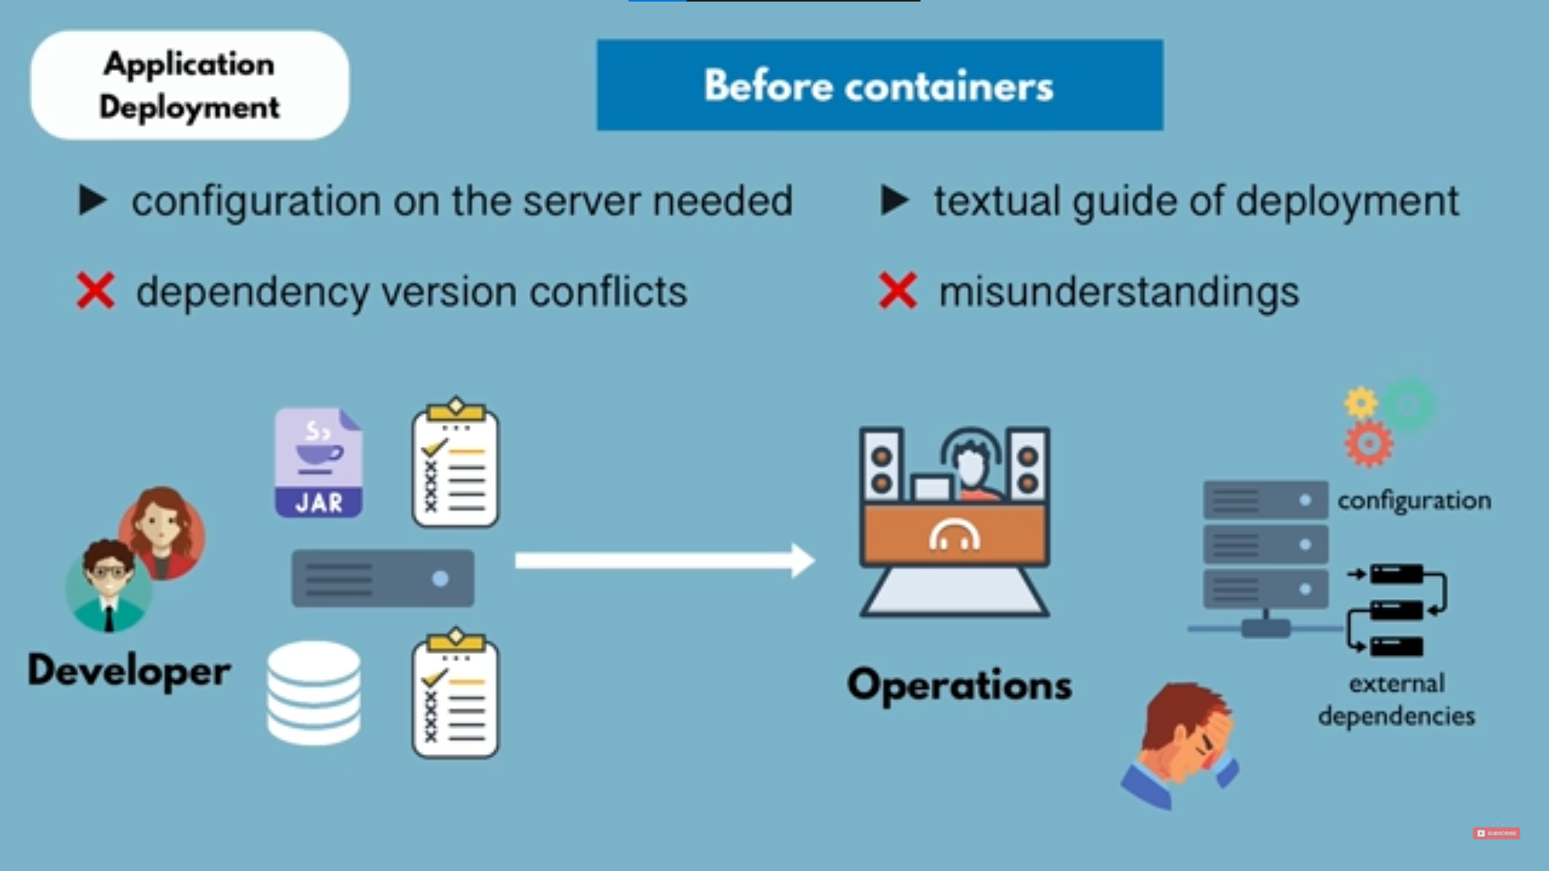

Slide 24
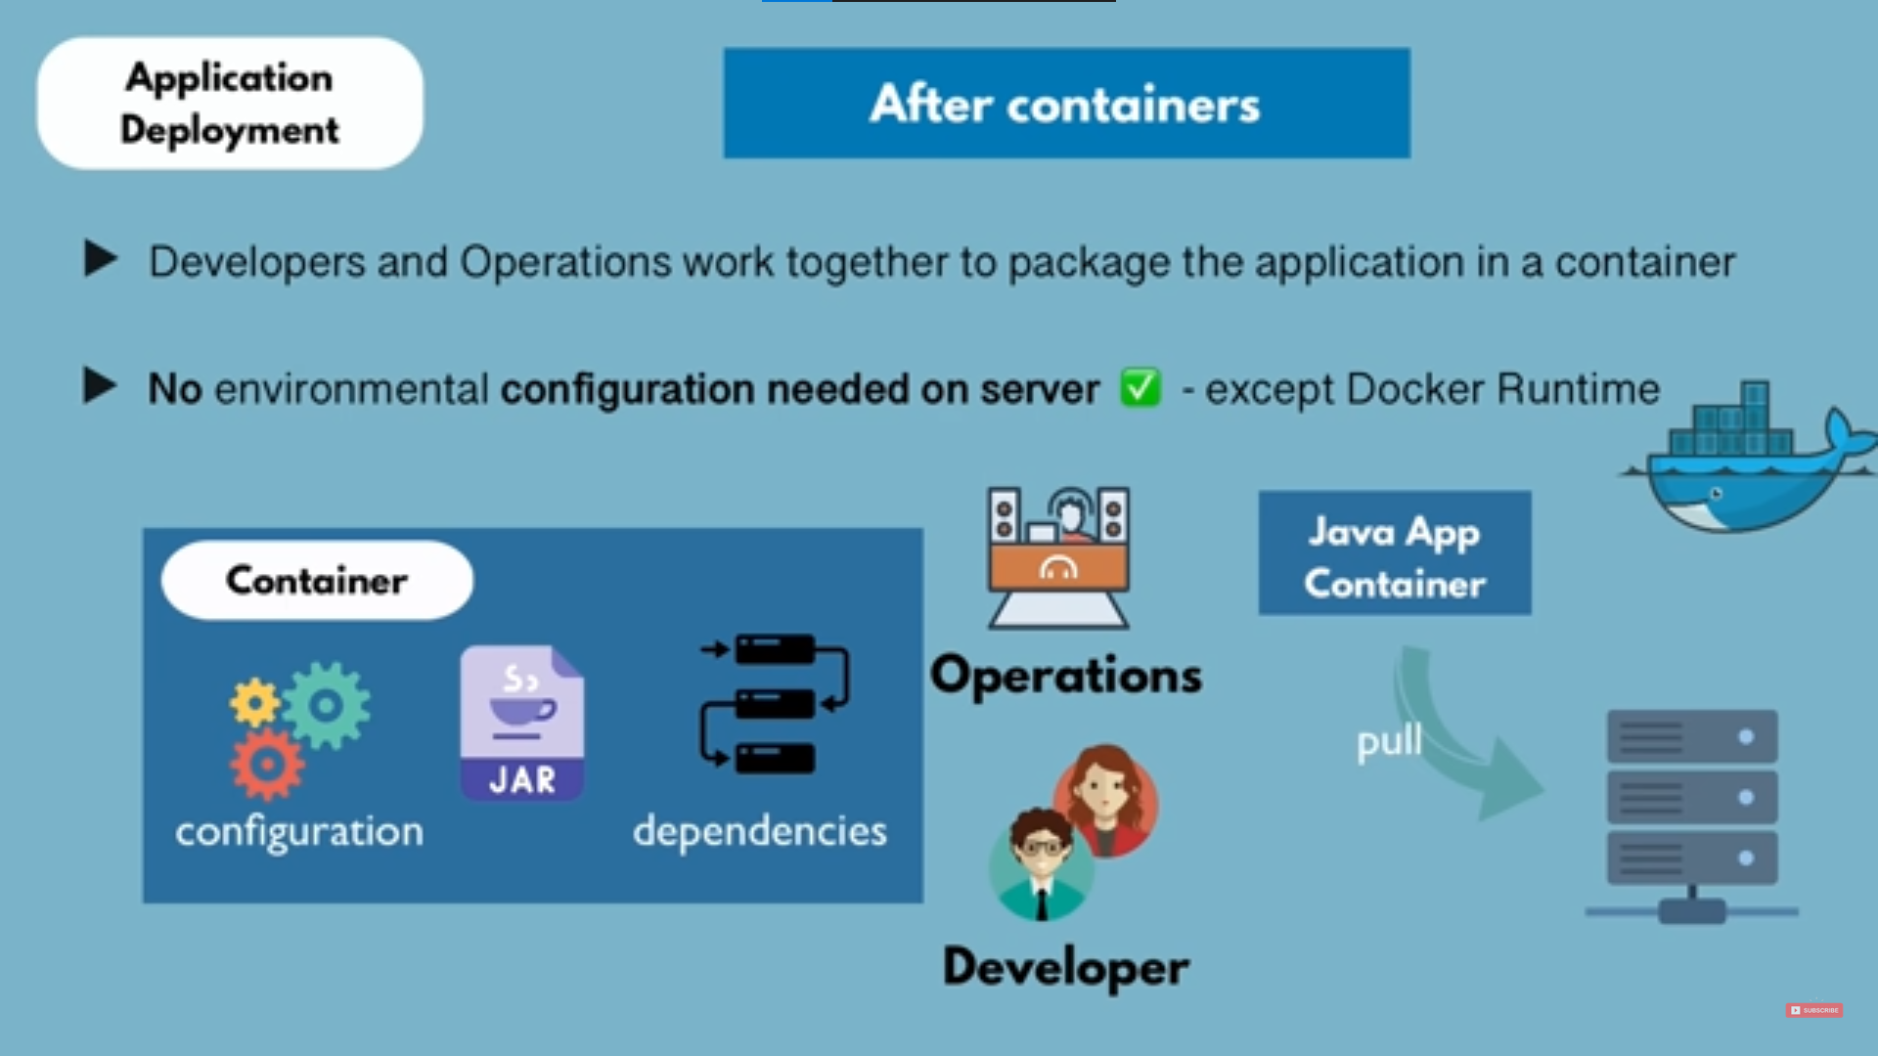

Slide 25
Docker Image
Docker image is built based on a docker file. A Docker file defines all the steps required to create a docker image with your application configured and ready to be run as a container. The image itself contains everything from all the dependencies to configurations required to run your application.

Slide 26
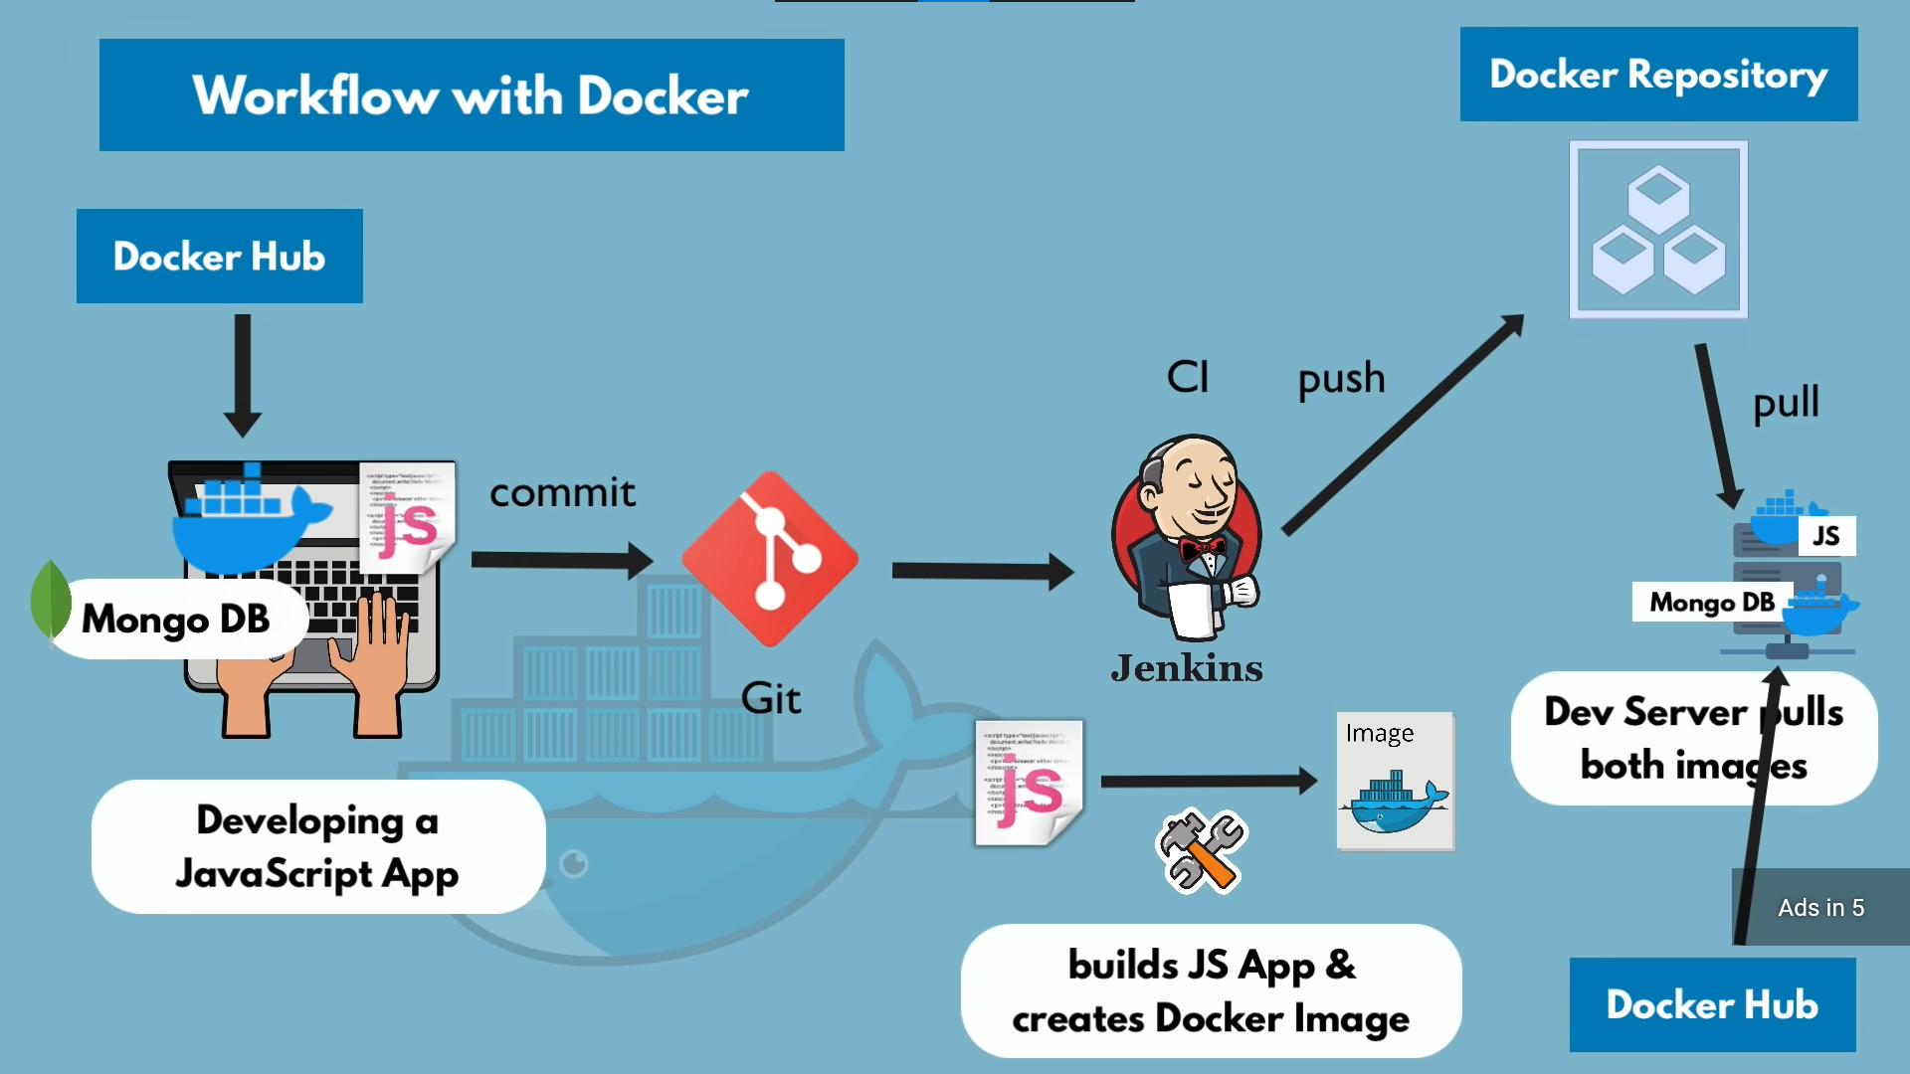

Slide 27
Continuous Monitoring
Once the application is deployed and is available for users, Continuous Monitoring will alert the teams if there are any application issues in that environment. This will provide necessary feedback to the team. And the team can understand the parts of the application that demand additional work.

Slide 28
Monitoring Tools
Instana
Instana is a fully automated Application Performance Management (APM) solution tool.
It shows real time data of users hitting a particular service of an web application

Slide 29
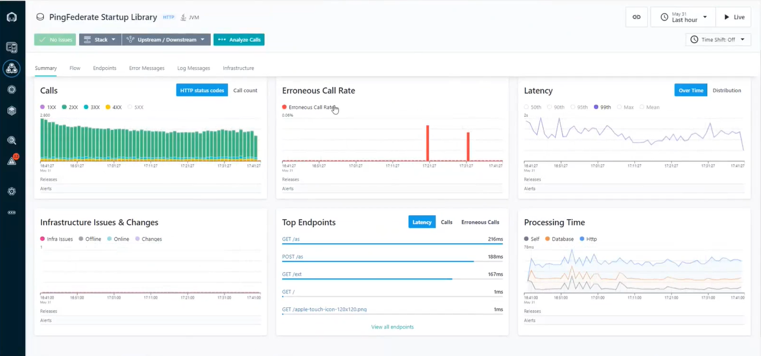

Slide 30
Grafana
Grafana is an open-source interactive visualization web application. It provides charts, graphs, dashboards and alerts for the web when connected to supported data source.
Grafana architect comprises of
Data Producer
Data Source
Grafana Dashboard
Grafana queries the data source and data source returns requested data which then is displayed on Grafana dashboard.

Slide 31
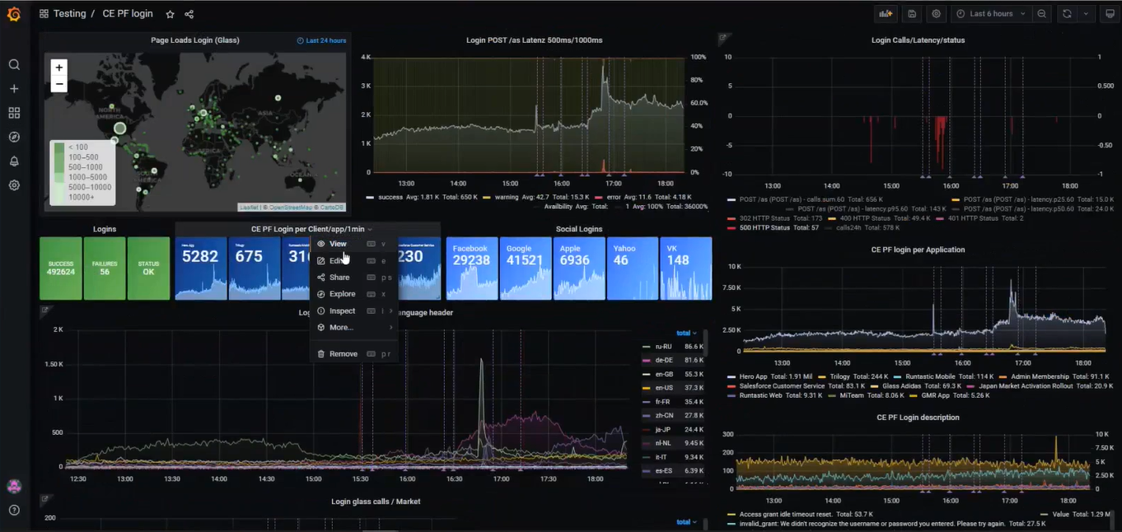

Slide 32
Thank You

